Slide 1

WELCOME

Slide 2

A Project On
HOSPITAL MANAGEMENT SYSTEM

Slide 3

Content
Introduction
Existing System
Proposed System
Advantages of Proposed System
Hardware and Software Requirements
Modules
Data Flow Diagram
ER Diagram
Database Table Structure
Conclusion

Slide 4
Introduction
“Hospital Administration” is aimed to achieving two ends.
The first helping the patients manage their records and a hospital manages its patients better.
This project work is inspired by the immense inconvenience faced by patients.
Patient administration.

Slide 5
Existing System
Present system is manual, hospital is taking all the information of patients manually.
Limitations of the Manual System :
It is time consuming
It leads to error prone results
It consumes a lot of manpower to better results
It lacks of data security
Retrieval of data takes lot of time
Percentage of accuracy is less
Report takes time to produce

Slide 6

Proposed system
Objectives of the proposed system
To provide huge maintenance of records
To generate the quick reports
To make accurate and efficient calculations
To provide proper information briefly
To provide data security
Flexibility of transaction can be completed on time

Slide 7
Advantages of Proposed system
Reduced data redundancy
Reduced updating errors and increased consistency
Improved data access to users through use of host and query languages
Improved data security
Reduced data entry, Storage and retrieval costs
Unique registration number

Slide 8
HARDWARE REQUIREMENTS
SOFTWARE REQUIREMENTS
Processor | INTEL Pentium 4 or Higher
RAM | 512 MB
Hard Disc | 20 GB
Operating System | Windows XP or Higher
Front End | PHP
Back End | MYSQL
Server | XAMP

Slide 9
Modules
Admin
Doctor
Patient

Slide 10
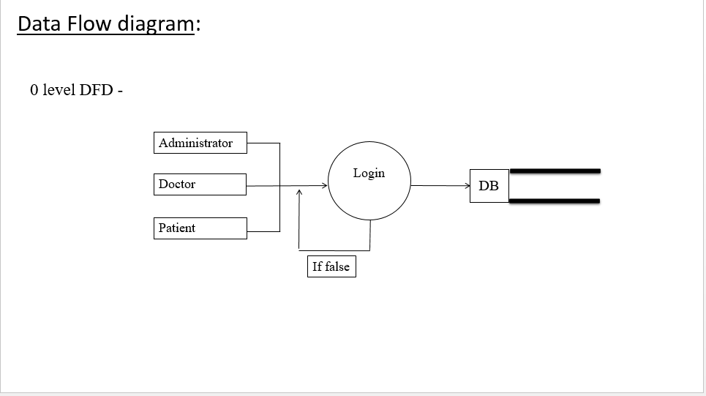

Slide 11
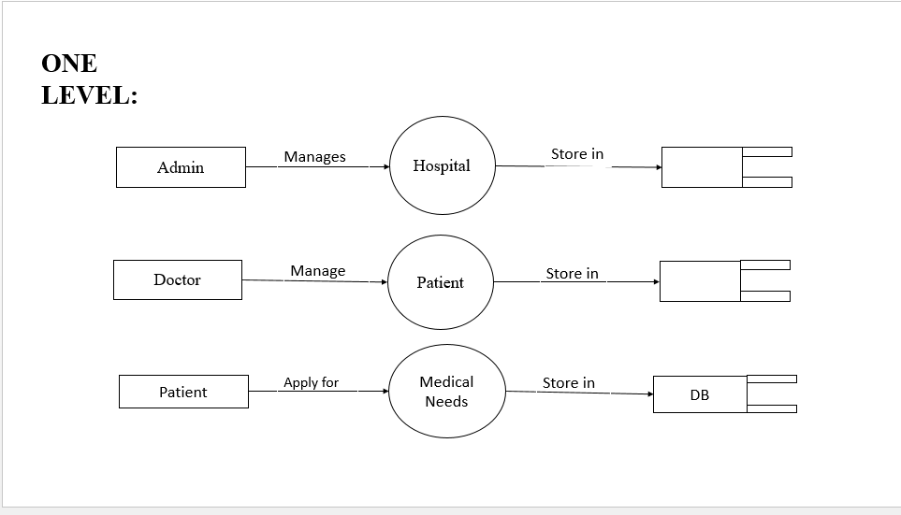
DB
DB

Slide 12
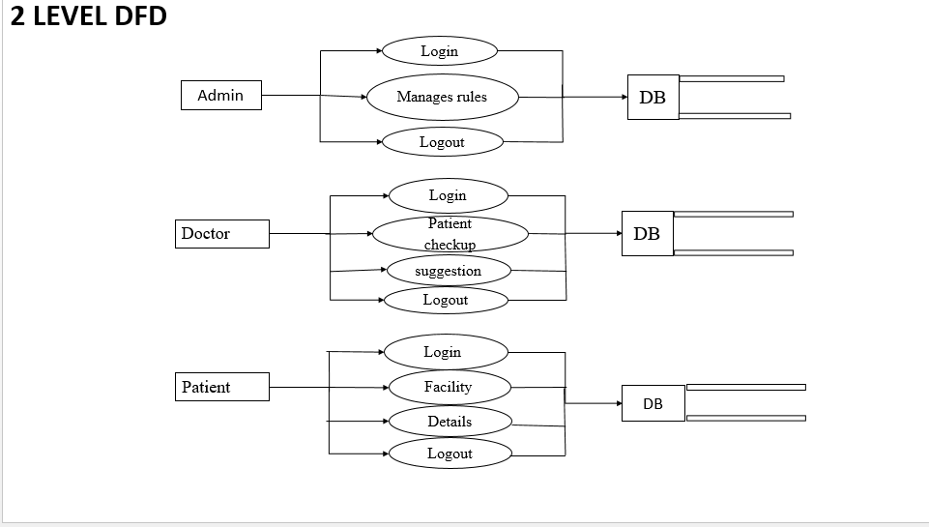

Slide 13
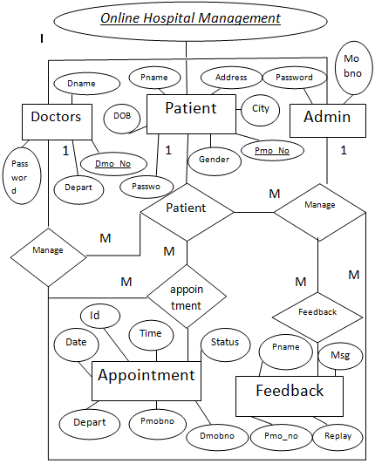
ER Diagram

Slide 14
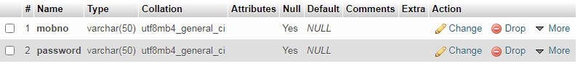
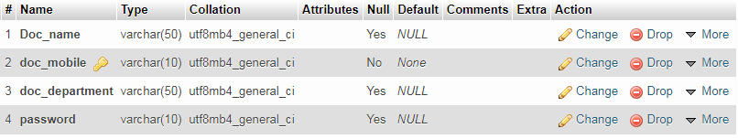
Admin
Doctor

Slide 15
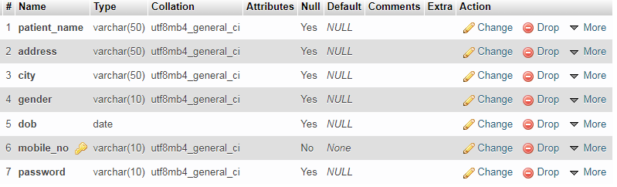
Patient

Slide 16

Admin Home Page

Slide 17
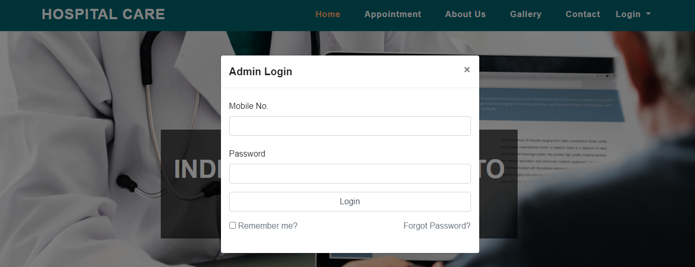
Admin Login Page

Slide 18
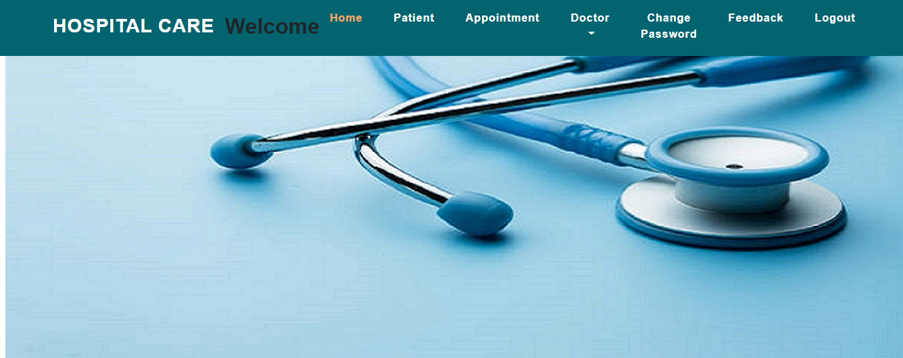
Admin Home Page

Slide 19
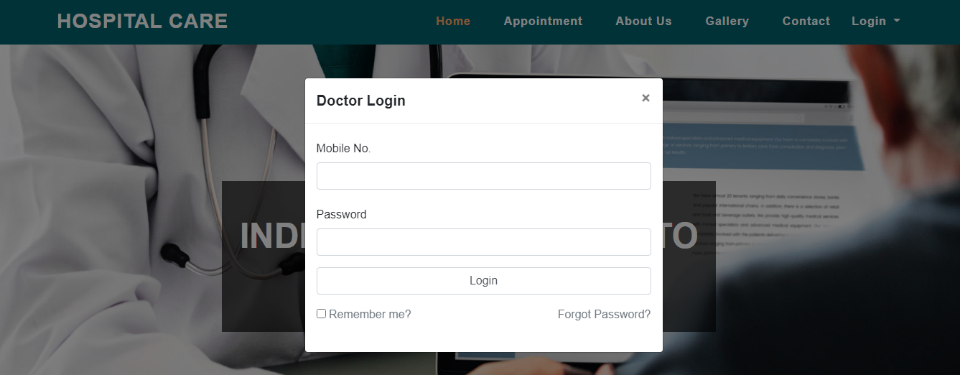
Doctor Login

Slide 20

Doctor Home Page

Slide 21
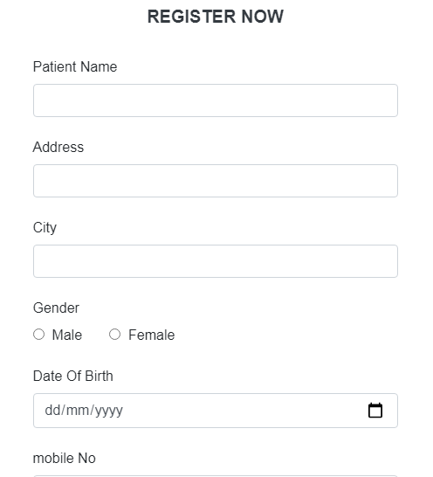
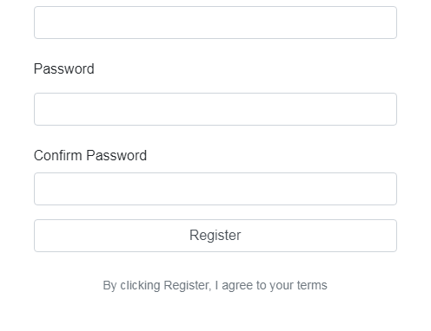
Patient Registration Form

Slide 22
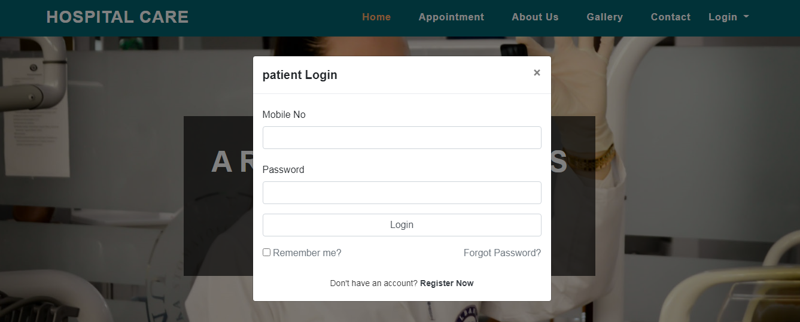

Patient Login
Patient Home Page

Slide 23
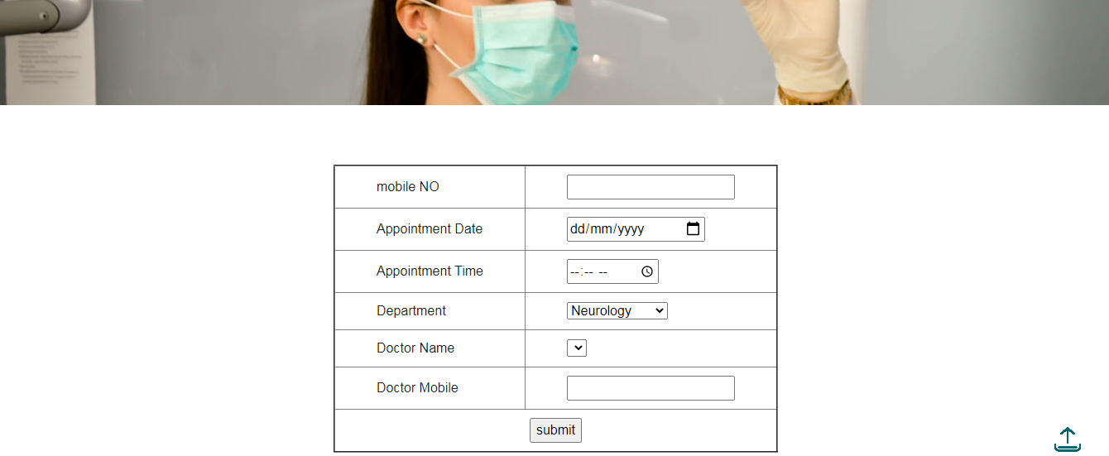
Appointment Page

Slide 24
CONCLUSION
Hospital management System is all about the modernizing a hospital through use of technology. Computers helps in it and take over the manual system for quick and easy functioning, All the basic requirements of the hospital are provided in the hospital in order to manage it perfectly and large amount of data can also be stored.

Slide 25

Thank you

